Slide 1
New Mexico:
Review of Rural Definitions
NCHEMS State Technical Support
June 2026

Slide 2
About NCHEMS
The National Center for Higher Education Management Systems (NCHEMS) partners with institution, system, government, and community leaders to effectively use evidence to improve strategic decision-making in postsecondary education.
Vision: We envision a future in which postsecondary education expands opportunities for all, strengthens communities, and advances the public good.

Slide 3








Project Team
Dan Armour
Accountant
Artemio Cardenas
Research Associate
Louisa Hunkerstorm
Senior Associate
Sarah Torres Lugo
Research Associate
Sarah Pingel
Vice President
Brian Prescott
President
Jacquelyn Villa
Project & Comms Manager

Slide 4

Review of New Mexico
Background
Objectives
Key Findings
Institutional Analysis
Student Analysis
Recommendations

Slide 5
Background
NCHEMS Project - Designing State Funding Models That Sustain Rural Colleges and Universities
Project Resources
  Policy Brief
  Rural Classifications and Definitions Guide
  Interactive Rural Definitions Map
  Webinar
State Technical Assistance
  Colorado
  Missouri
  New Mexico
  Oregon
  Pennsylvania
Final Report
  Upcoming release

Slide 6
Objectives in New Mexico
Context
  New Mexico is a predominantly rural state
  The state funding model does not explicitly consider rurality in the components of the higher education funding formula
Objectives of our state technical assistance
  Review and apply commonly used rural definitions at the institutional level
  Apply the different definitions at the institutional and student levels
  Create recommendations for NMHED to review

Slide 7
Key Findings
1) Not all rural definitions fit the New Mexico context
2) No single “correct” rural definition
3) Student data matters
4) Use of definitions and analysis depend on policy objectives

Slide 8
Rural Definitions

Slide 9
Rural Definitions
Metropolitan/Non-Metropolitan Areas
Rural-Urban Commuting Area Codes (RUCA)
County Rural Percentage 50%+
NCES Locale Codes
Rural Serving Institutions (RSI)

Slide 10
Metropolitan/Non-Metro
U.S. Census Bureau (Office of Management and Budget designations)
County-level
Metropolitan (Metro) statistical area defined as urban core ≤ 50,000 population
Non-metro – Counties with ≤ 49,999

Slide 11
Rural-Urban Commuting Area Codes (RUCA)
US Department of Agriculture – Economic Research Service
Census Tract
Urbanization level and daily community patterns (U.S. Census Journey-to-work data)
Census-defined urbanization clusters of ≥ 10,000 population
Rural is considered tracts in small towns (2,500 – 9,999) or isolated rural areas

Slide 12
Census County Rural Population (≥ 50% Rural)
U.S. Census Bureau
County-level
Rural is defined as a county where a majority (≥ 50%) of its population lives in areas classified as rural by the Census.
  Census rural definition is any population no classified as urban (urbanized areas ≥ 50,000 or urban clusters 2,500–49,999)

Slide 13
NCES Locale Codes
National Center for Education Statistics (NCES)
School or district address
Based on urbanized areas
Town/Rural areas are subclassified by distance to the nearest urbanized area
Four major locales
  City
  Suburban
  Town
  Rural
Subclassifications
  Large, Midsize, Small, Fringe, Distant, Remote

Slide 14
Rural Serving Institutions (RSIs)
Developed by the Alliance for Research on Regional Colleges (ARRC)
Released in 2022
Composite index which includes five indicators of institutional and regional rurality
A continuous metric that allows for different thresholds
  This study counts all institutions above the total RSI score as an RSI.

Slide 15
Institutional Analysis
Applying the different rural definitions to institutions

Slide 16
Institutional Analysis
(Data and Methods)
IPEDS Data
  Institution
  Location data
Rural Definitions Sources
  US Census
  NCES
  Office of Budget and Management
  US Department of Agriculture
  Association of Research on Regional Colleges (ARRC)
Classifications and mapping conducted using R (statistical package)

Slide 17
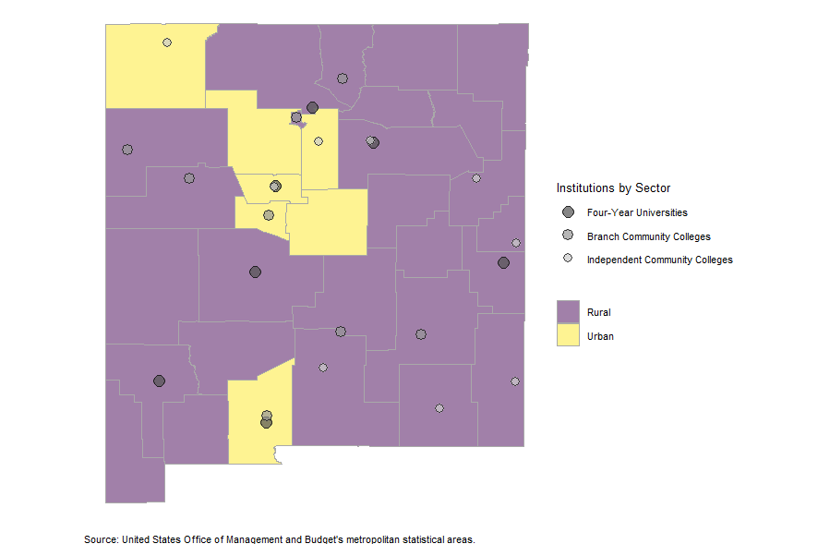
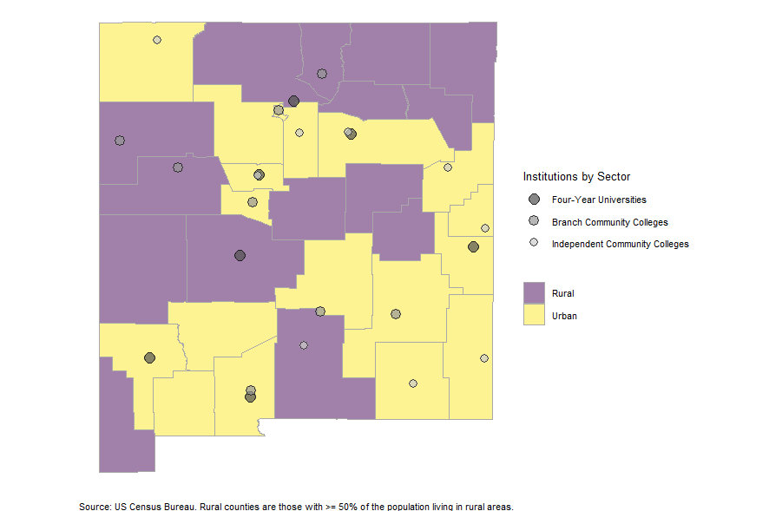
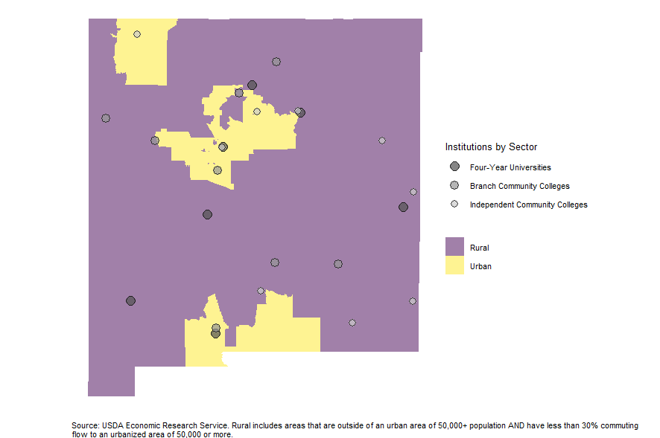
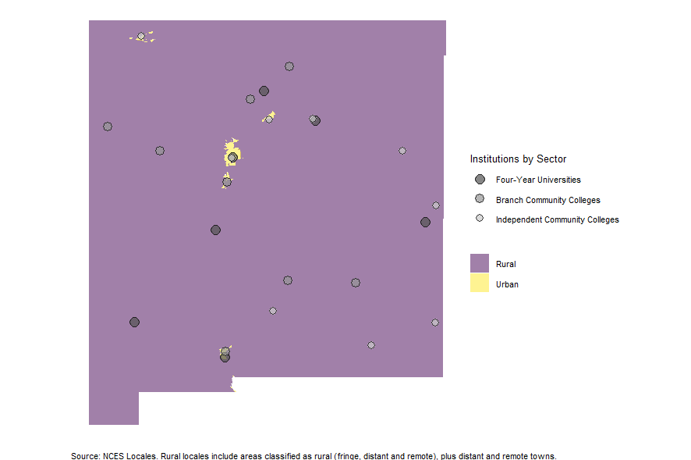
Differences in Rural Definitions
Metro/Non-Metro
Percent County Rural
RUCA
NCES Locale

Slide 18

Poor Definition Fit for NM
Percent of County Rural 50%+

Slide 19
Comparison Table
All Definitions
Institution | Metro/Micro Classification | Percent of County Rural Classification | NCES Locale Classification | Rural-Serving Institution Classification | RUCA Classification | Rural Match
Four-year Research
University of New Mexico-Main Campus | Non-Rural | Non-Rural | City - Large | Non Rural-Serving | Non-Rural | Not All Rural
New Mexico State University-Main Campus | Non-Rural | Non-Rural | Suburb - Midsize | Non Rural-Serving | Non-Rural | Not All Rural
New Mexico Institute of Mining and Technology | Rural | Rural | Town - Remote | Rural-Serving | Rural | All Rural/Town
Four-year Comprehensives
Western New Mexico University | Rural | Non-Rural | Town - Remote | Rural-Serving | Rural | Not All Rural
Northern New Mexico College | Rural | Rural | Town - Distant | Rural-Serving | Rural | All Rural/Town
New Mexico Highlands University | Rural | Non-Rural | Town - Remote | Rural-Serving | Rural | Not All Rural
Eastern New Mexico University-Main Campus | Rural | Non-Rural | Town - Remote | Rural-Serving | Rural | Not All Rural
Branch Campuses
University of New Mexico-Valencia County Campus | Non-Rural | Non-Rural | Rural – Fringe | Non Rural-Serving | Non-Rural | Not All Rural
University of New Mexico-Taos Campus | Rural | Rural | Rural – Fringe | Rural-Serving | Rural | All Rural/Town
University of New Mexico-Los Alamos Campus | Rural | Non-Rural | Town - Distant | Rural-Serving | Rural | Not All Rural
University of New Mexico-Gallup Campus | Rural | Rural | Town - Remote | Rural-Serving | Rural | All Rural/Town
New Mexico State University-Alamogordo | Rural | Rural | Rural - Fringe | Rural-Serving | Rural | All Rural/Town
New Mexico State University-Grants | Rural | Rural | Town - Remote | Rural-Serving | Rural | All Rural/Town
New Mexico State University-Dona Ana | Non-Rural | Non-Rural | City - Midsize | Non Rural-Serving | Non-Rural | Not All Rural
Eastern New Mexico University-Roswell Campus | Rural | Non-Rural | Town - Remote | Rural-Serving | Rural | Not All Rural
Eastern New Mexico University Ruidoso Branch | Rural | Non-Rural | Town - Remote | Rural-Serving | Rural | Not All Rural
Independent Community Colleges
Central New Mexico Community College | Non-Rural | Non-Rural | City - Large | Non Rural-Serving | Non-Rural | Not All Rural
Clovis Community College | Rural | Non-Rural | Town - Remote | Rural-Serving | Rural | Not All Rural
New Mexico Junior College | Rural | Non-Rural | Town - Remote | Rural-Serving | Rural | Not All Rural
Southeast New Mexico College | Rural | Non-Rural | Rural – Fringe | Rural-Serving | Rural | Not All Rural
San Juan College | Non-Rural | Non-Rural | Rural – Fringe | Rural-Serving | Non-Rural | Not All Rural
Santa Fe Community College | Non-Rural | Non-Rural | Rural – Fringe | Rural-Serving | Non-Rural | Not All Rural
Mesalands Community College | Rural | Non-Rural | Town – Remote | Rural-Serving | Rural | Not All Rural
Luna Community College | Rural | Non-Rural | Rural – Fringe | Rural-Serving | Rural | Not All Rural

Slide 20
Comparison Table
Focused - NCES Locale, RSI, RUCA
Institution | NCES Locale Classification | Rural-Serving Institution Classification | RUCA Classification | Rural Match
Four-year Research
University of New Mexico-Main Campus | City - Large | Non Rural-Serving | Non-Rural | Not All Rural
New Mexico State University-Main Campus | Suburb - Midsize | Non Rural-Serving | Non-Rural | Not All Rural
New Mexico Institute of Mining and Technology | Town - Remote | Rural-Serving | Rural | All Rural/Town
Four-year Comprehensives
Western New Mexico University | Town - Remote | Rural-Serving | Rural | All Rural/Town
Northern New Mexico College | Town - Distant | Rural-Serving | Rural | All Rural/Town
New Mexico Highlands University | Town - Remote | Rural-Serving | Rural | All Rural/Town
Eastern New Mexico University-Main Campus | Town - Remote | Rural-Serving | Rural | All Rural/Town
Branch Campuses
University of New Mexico-Valencia County Campus | Rural – Fringe | Non Rural-Serving | Non-Rural | Not All Rural
University of New Mexico-Taos Campus | Rural – Fringe | Rural-Serving | Rural | All Rural/Town
University of New Mexico-Los Alamos Campus | Town - Distant | Rural-Serving | Rural | All Rural/Town
University of New Mexico-Gallup Campus | Town - Remote | Rural-Serving | Rural | All Rural/Town
New Mexico State University-Alamogordo | Rural - Fringe | Rural-Serving | Rural | All Rural/Town
New Mexico State University-Grants | Town - Remote | Rural-Serving | Rural | All Rural/Town
New Mexico State University-Dona Ana | City - Midsize | Non Rural-Serving | Non-Rural | Not All Rural
Eastern New Mexico University-Roswell Campus | Town - Remote | Rural-Serving | Rural | All Rural/Town
Eastern New Mexico University Ruidoso Branch | Town - Remote | Rural-Serving | Rural | All Rural/Town
Independent Community Colleges
Central New Mexico Community College | City - Large | Non Rural-Serving | Non-Rural | Not All Rural
Clovis Community College | Town - Remote | Rural-Serving | Rural | All Rural/Town
New Mexico Junior College | Town - Remote | Rural-Serving | Rural | All Rural/Town
Southeast New Mexico College | Rural – Fringe | Rural-Serving | Rural | All Rural/Town
San Juan College | Rural – Fringe | Rural-Serving | Non-Rural | Not All Rural
Santa Fe Community College | Rural – Fringe | Rural-Serving | Non-Rural | Not All Rural
Mesalands Community College | Town – Remote | Rural-Serving | Rural | All Rural/Town
Luna Community College | Rural – Fringe | Rural-Serving | Rural | All Rural/Town

Slide 21
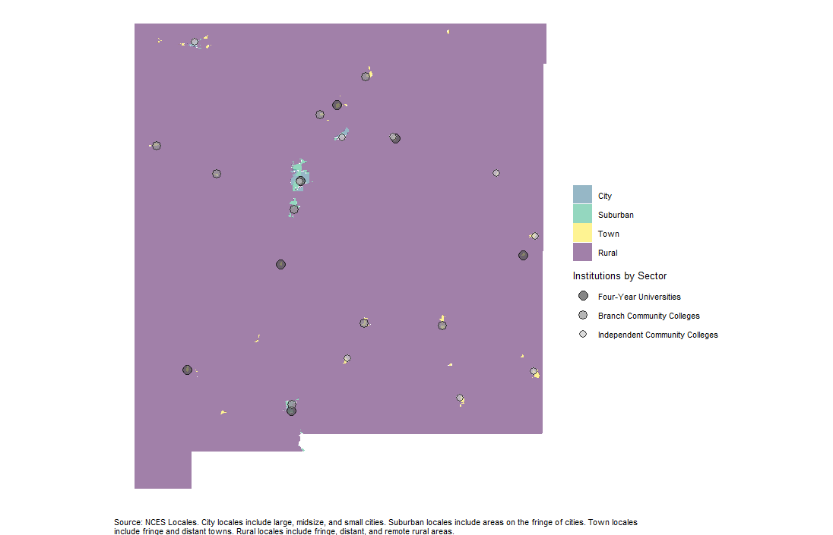
Improved Definition Fit for NM
NCES Locale

Slide 22
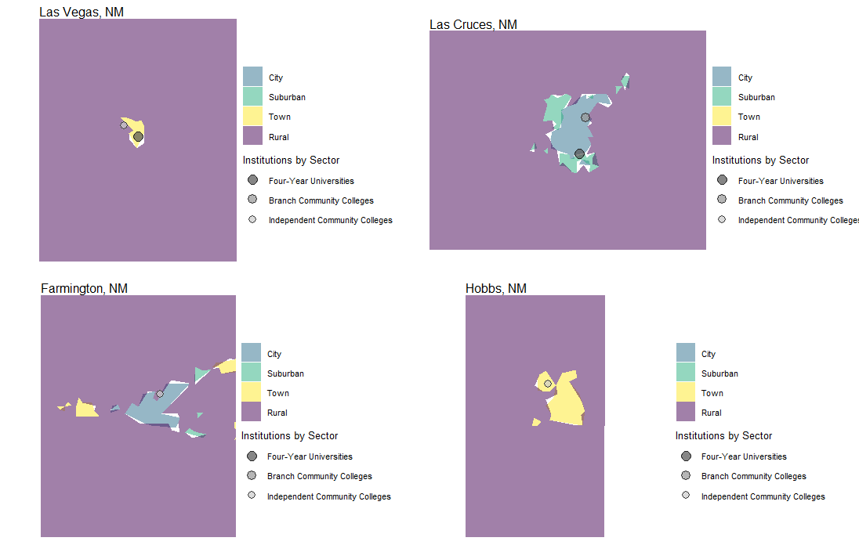
Improved Definition Fit for NM
NCES Locale

Slide 23
Institutional Analysis - Findings
Not all definitions fit New Mexico
  The percent of the county that is rural (50%+)
  Metro/Non-Metro
Findings from the comparative analysis
  Overall, most definitions align
  NCES Locale and RSI align
    Exception UNM-Valencia
  RUCA codes align with NCES and RSI
    Exception San Juan and Santa Fe CCs
Recommended definitions for institutional analysis in New Mexico
  NCES Locale Codes
  ARRC’s Rural Serving Institution
  RUCA

Slide 24
Student Analysis Process
Applying various definitions of rurality using student-level data

Slide 25
Student Origin Analysis
(Data and Methods)
Student origin data
  NMHED provided the originating high school for each student
  Urban Institute file for high school details (NCES Common Core Data)
Definition data
  NCES Locales
  Rural Urban Commuting Area (RUCA)
Methods
  Multi-stage matching process
  Classifications and visualizations conducted using R

Slide 26
Matching – Coverage Summary
Data Sources
  NMHED provided the originating high school for each student (2025)
  CU Boulder CEEB-to-NCES Crosswalk
  NCES Common Core of Data — Common Core Data via Urban Institute (2022)
  NCES Private School Survey — PSS (2021-22)
Matching Approach
  10-tier hierarchical matching procedure – Claude assisted
  Each tier attempted only on schools unmatched in all prior tiers
  Tiers 1–6 match public & charter schools to CCD
  Tiers 7–10 match private schools to PSS
  Matching priority: exact code match → exact name match → fuzzy name match
  All name-based joins used consistent text normalization
Analysis Note
  All figures are based on proportions calculated solely from matched enrollment data

Slide 27
Matching – Coverage Summary
  NMHED Dataset
    365 NM High Schools
  ACT Dataset
    484 NM High Schools
  CU Boulder Crosswalk
    184 NM High Schools
  Multiple Tiered Approach
    Joined using
      HS Name, HS City, HS County

Slide 28
Matching Diagnostics
School Type | Total Schools | Total Students | Matched Schools | Matched Students | Unmatched Schools | % Schools Matched
Public | 150 | 175,665 | 136 | 175,089 | 14 | 90.7%
Alternative | 16 | 4,176 | 15 | 4,151 | 1 | 93.8%
Charter | 58 | 14,912 | 44 | 12,994 | 14 | 75.9%
Early College High School (ECHS) | 17 | 11,224 | 15 | 8,271 | 2 | 88.2%
Private | 111 | 8,071 | 37 | 4,991 | 74 | 33.3%
Bureau of Indian Education (BIE) High School | 1 | 637 | 0 | 0 | 1 | 0%
Grant | 7 | 2,724 | 0 | 0 | 7 | 0%
Special State-Supported | 4 | 844 | 0 | 0 | 4 | 0%
Unknown | 1 | 1 | 0 | 0 | 1 | 0%

Slide 29
Match Coverage by High School Type
School Coverage
Total Unique High Schools | 365
Matched Schools | 247
Unmatched Schools | 118
School Coverage Rate | 67.7%
Student Coverage
Total Students | 218,254
Matched Students | 205,496
Unmatched Students | 12,758
Student Coverage Rate | 94.2%

Slide 30
Student Analysis
Applying the different rural definitions to student origin data

Slide 31
Matching – Coverage Summary
Types of students excluded
  Out-of-state
  International
  Home schooled
  Some tribal schools
  Schools not in the NCES database
  Those without location data
Students included in analysis
  First-time First-year
  Other degree seeking undergraduates
Excluded
  Graduate students
  High School Concurrent - Dual-enrolled students
  All non dual credit, non-degree seeking

Slide 32
Student Analysis
Enrollment Heat Maps
  County-level
  By institution
Feeder Counties
Institutional share of rural students
  By institution
Student Flow
  By NCES Locale groups to each institution

Slide 33
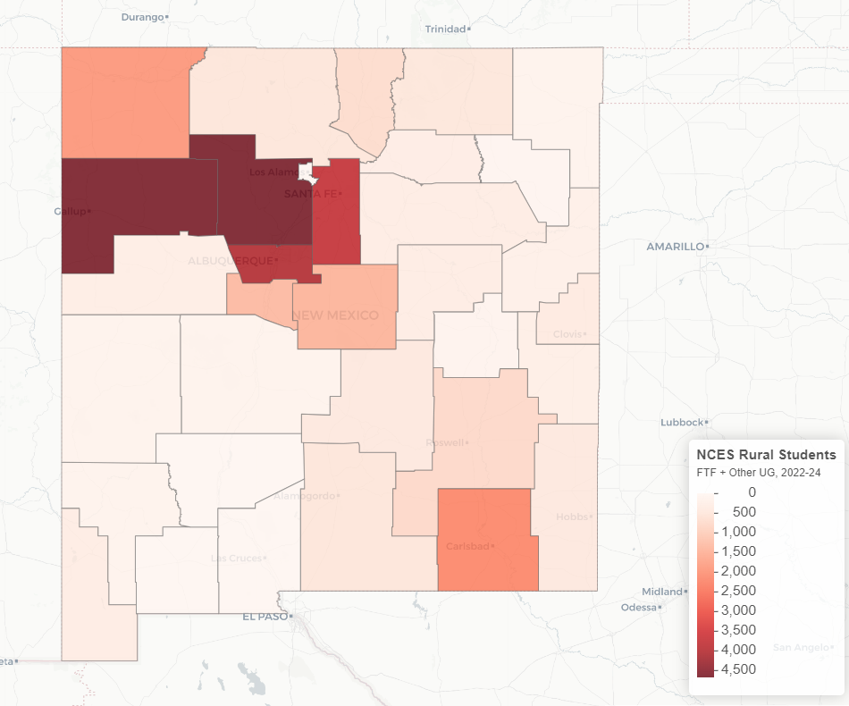
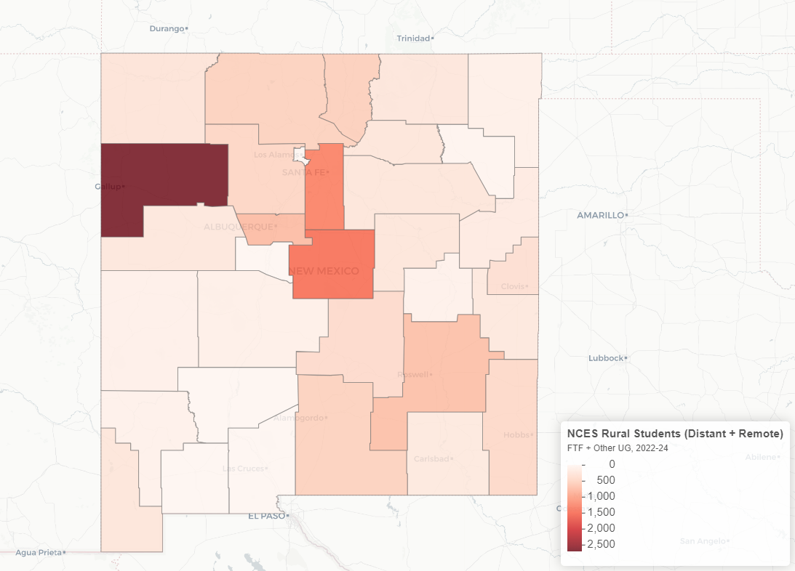
Heat Maps
Enrollment Map – All Rural UG Students
NCES Locale - Rural
NCES Locale – Rural Strict
Notes:
Rural Strict excludes students from high schools designated as “Rural Fringe.” The reason is that there are a handful of large high schools located outside of Albuquerque.

Slide 34
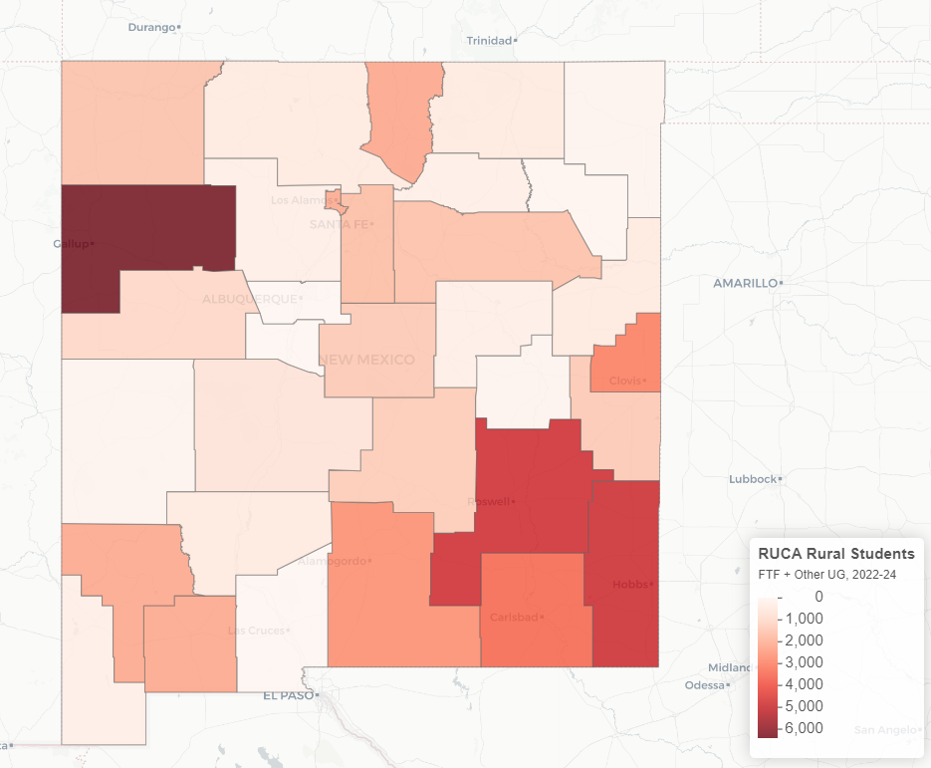
Heat Maps
Enrollment Map – All Rural UG Students using RUCA

Slide 35
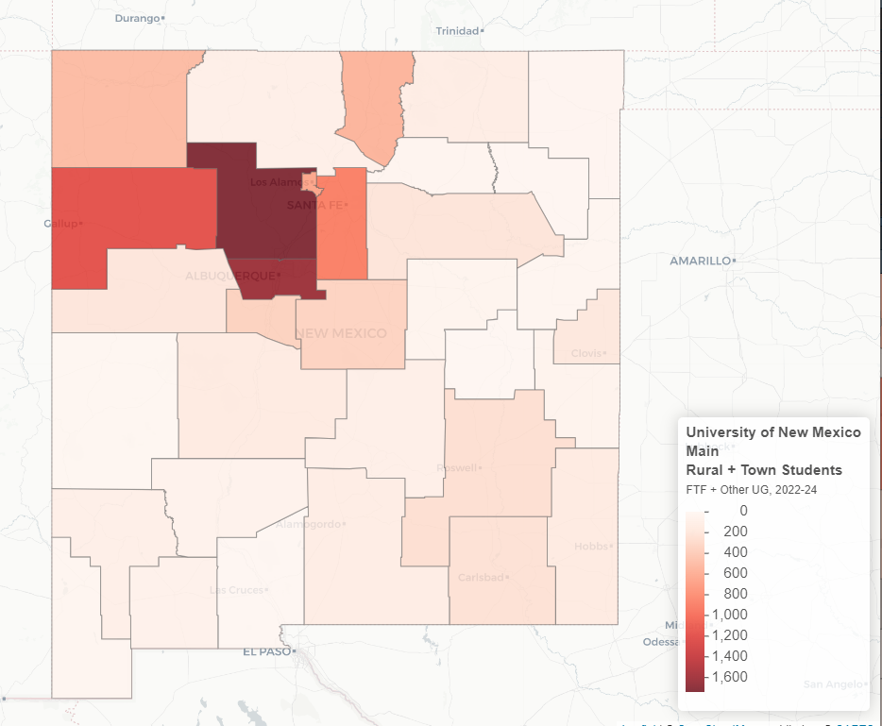
Heat Map
University of New Mexico Rural Enrollment

Slide 36
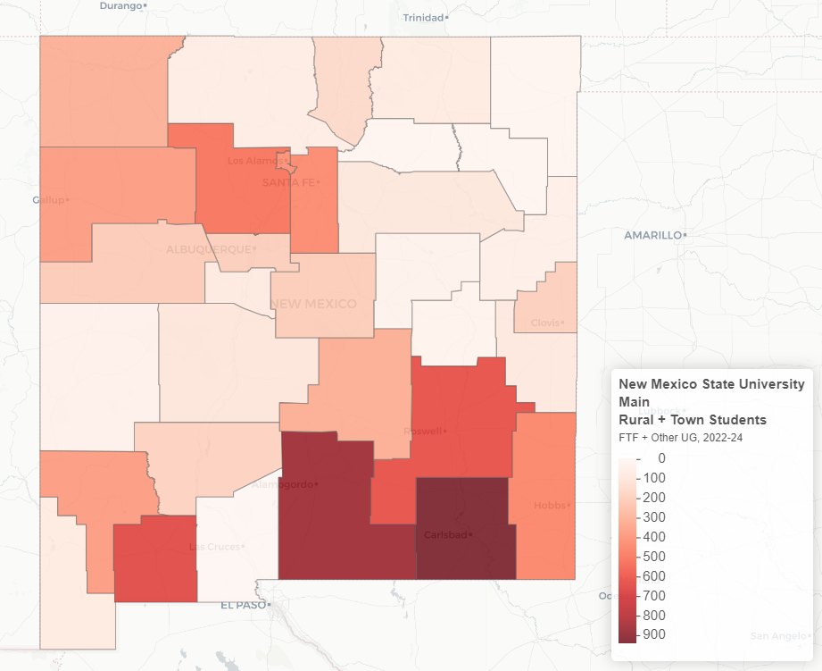
Heat Maps
New Mexico State University Rural Enrollment

Slide 37
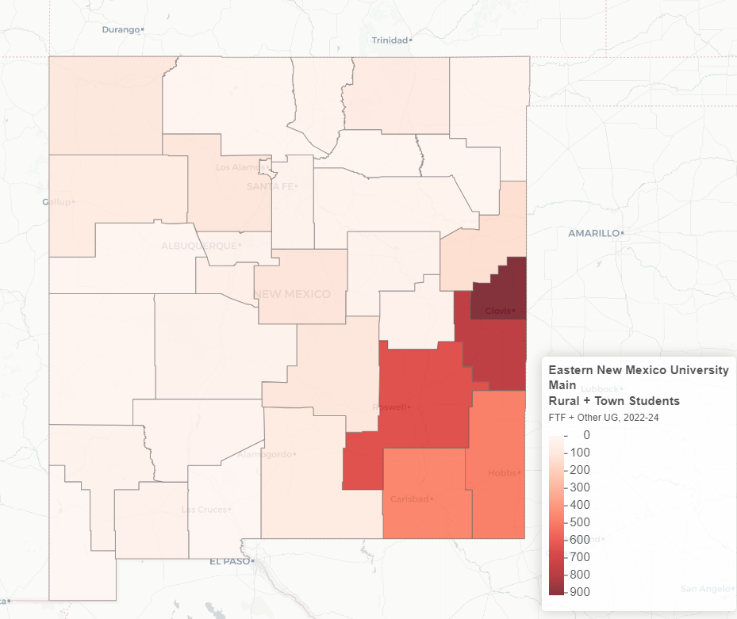
Heat Maps
Eastern New Mexico State University Rural Enrollment

Slide 38
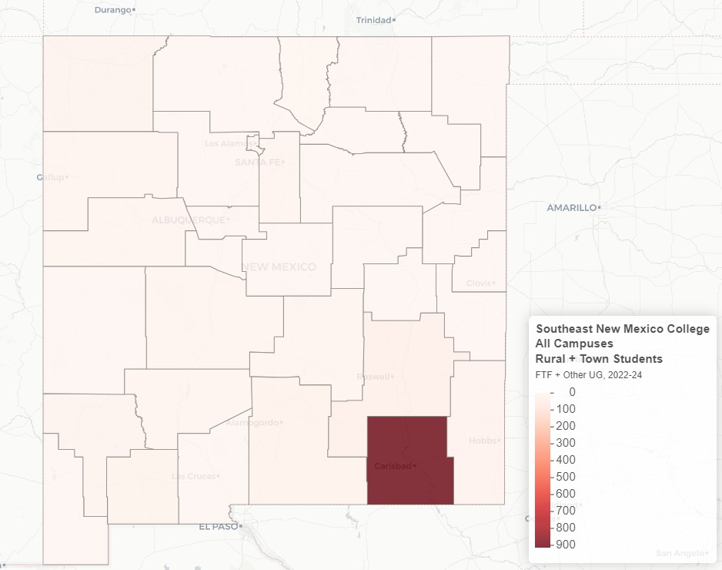
Heat Map
Southeastern New Mexico Rural Enrollment

Slide 39
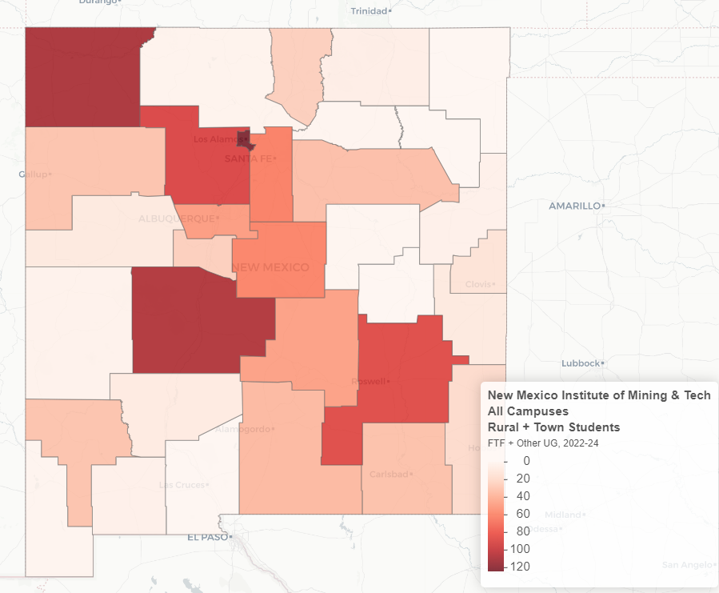
Heat Maps
New Mexico Tech Rural Enrollment

Slide 40
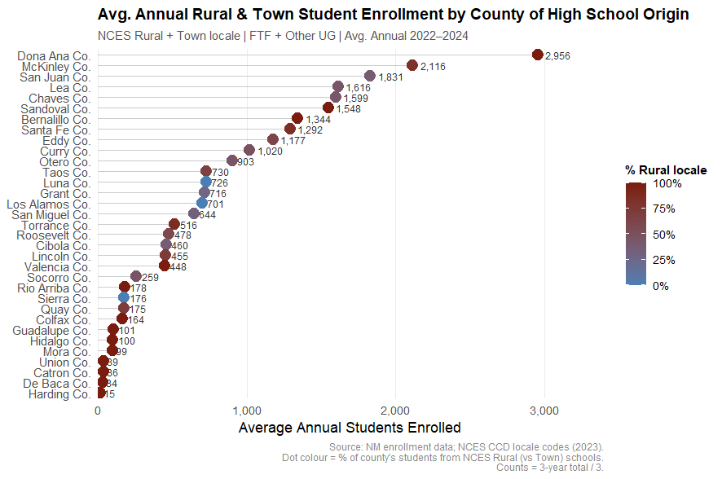
Feeder Counties

Slide 41
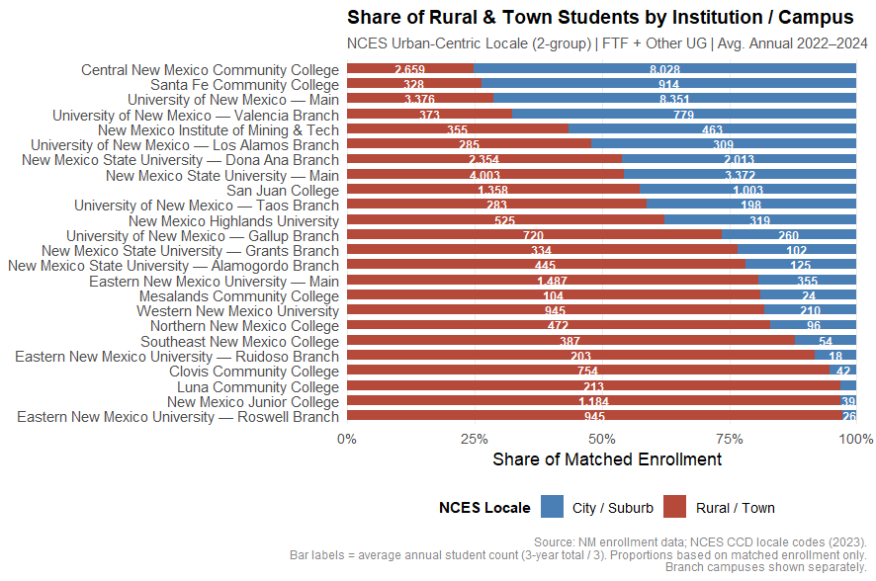
Share of Rural Students

Slide 42
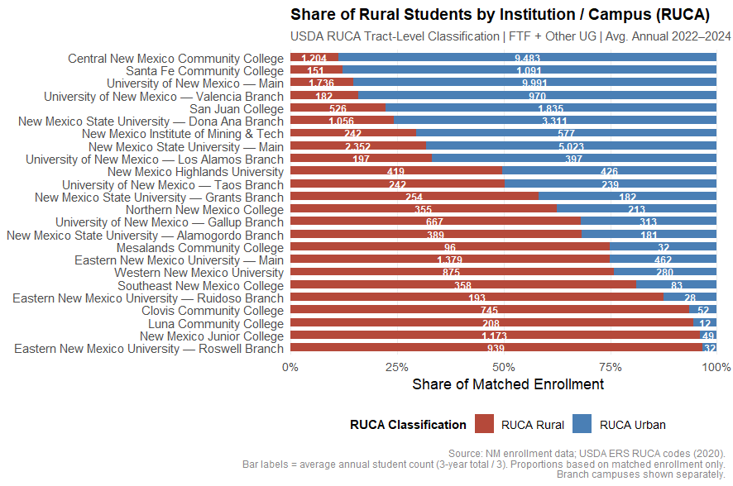
Share of Rural Students

Slide 43
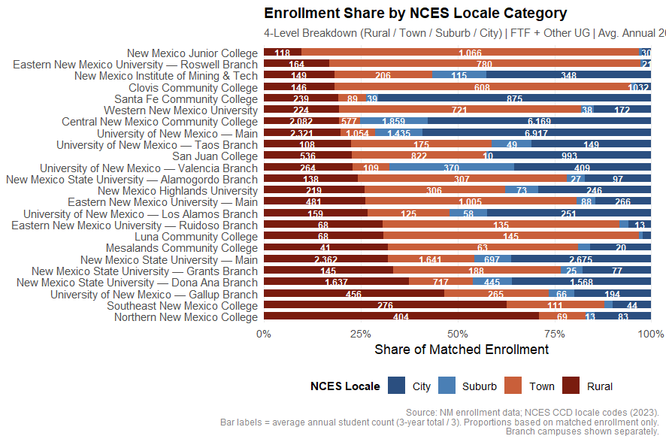
All Locales
Notes:
Consideration of the town locale matters

Slide 44
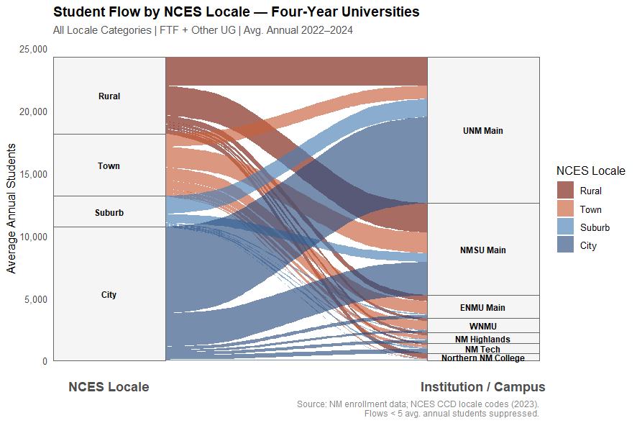
Four-Year Institutions

Slide 45
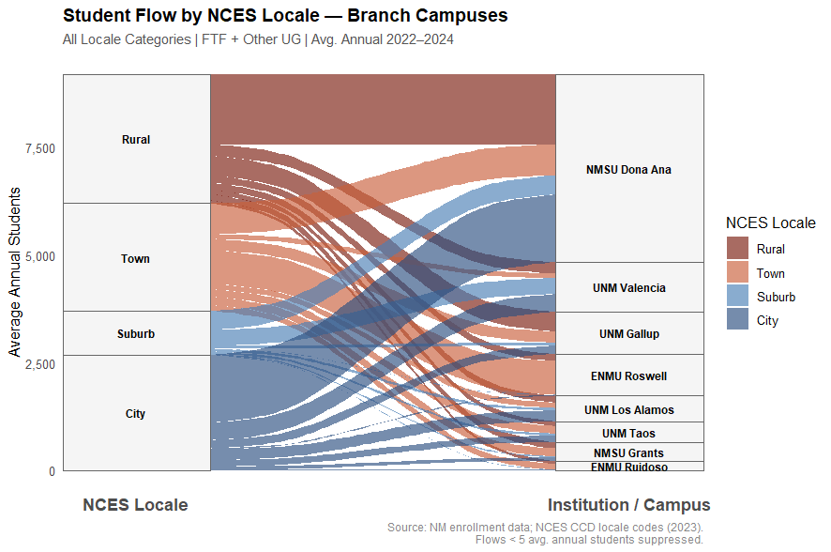
Branch Campuses

Slide 46
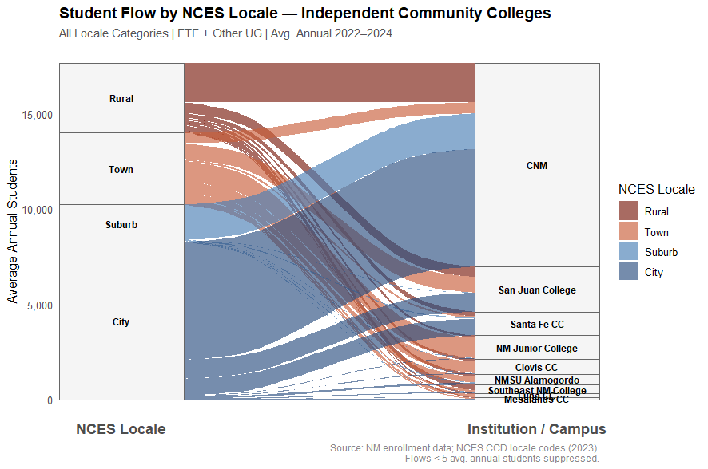
Independent Community Colleges

Slide 47
Continuum Approach
Considering Institution and Students

Slide 48
NM Rural Serving Institution (Strict)
Institution / Campus | % Rural Strict
Northern New Mexico College | 31.6
Luna Community College | 29.4
Eastern New Mexico University — Ruidoso Branch | 25.5
Mesalands Community College | 24.4
New Mexico State University — Grants Branch | 19.1
University of New Mexico — Gallup Branch | 18.8
Eastern New Mexico University — Main | 16.9
Clovis Community College | 16.7
New Mexico Highlands University | 16.4
New Mexico State University — Alamogordo Branch | 14.8
Eastern New Mexico University — Roswell Branch | 14.3
University of New Mexico — Los Alamos Branch | 12.6
Western New Mexico University | 12.6
New Mexico State University — Dona Ana Branch | 11.5
New Mexico State University — Main | 10.9
Notes:
Without students

Slide 49
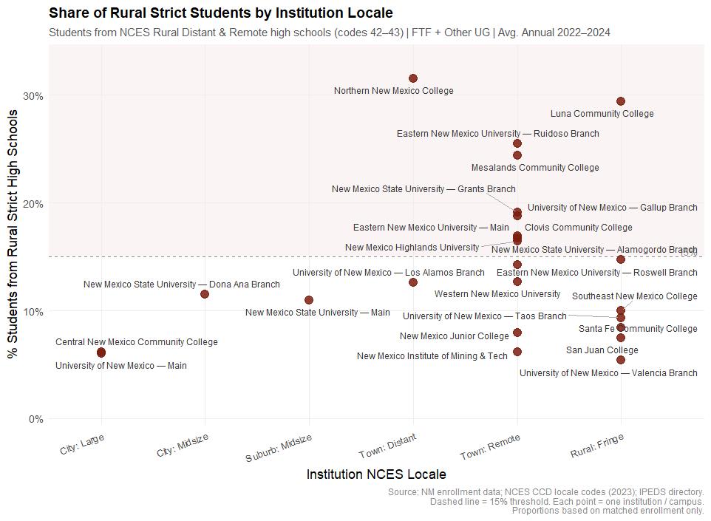
NM Rural Serving Institutions (Strict)

Slide 50
NM Rural Serving Institution (Strict)
Institution / Campus | Avg. Annual Total | Avg. Annual Rural Strict | % Rural Strict
Northern New Mexico College | 568 | 179 | 31.6
Luna Community College | 220 | 65 | 29.4
Eastern New Mexico University — Ruidoso Branch | 221 | 56 | 25.5
Mesalands Community College | 128 | 31 | 24.4
New Mexico State University — Grants Branch | 436 | 83 | 19.1
University of New Mexico — Gallup Branch | 980 | 184 | 18.8
Eastern New Mexico University — Main | 1,841 | 312 | 16.9
Clovis Community College | 796 | 133 | 16.7
New Mexico Highlands University | 844 | 139 | 16.4
New Mexico State University — Alamogordo Branch | 569 | 84 | 14.8
Eastern New Mexico University — Roswell Branch | 971 | 139 | 14.3
University of New Mexico — Los Alamos Branch | 594 | 75 | 12.6
Western New Mexico University | 1,155 | 146 | 12.6
New Mexico State University — Dona Ana Branch | 4,367 | 502 | 11.5
New Mexico State University — Main | 7,375 | 807 | 10.9
Notes:
With students

Slide 51
Recommendations
Institutional Heatmaps
Institutions not included in the merge

Slide 52






Recommendations
Adopt definitions
Classify
Analyze outcomes
NCES Locale as primary, RUCA as secondary
Students and institutions, informed by student origin data
For rural students and institutions
Ground objectives
Allocate accordingly
Refine process
Base policy goals on analysis of gaps and challenges
Consider rurality in the state funding formula
Address Rural Fringe high schools; improve high school matching

Slide 53
Recommendations
Adopt NCES Locale as primary and RUCA as a secondary definition
  NCHEMS does not recommend Metro/Non-Metro or Percent of County Rural designations. These measures set an overly high bar for rurality, exclude many rural communities, and do not fit the New Mexico context for classifying either institutions or high schools. NCES Locale codes provide a more appropriate and nuanced measure of rurality for the state.
  NMHED should also consider using RUCA codes as a secondary check.
Consider excluding or separately flagging, reclassifying high schools designated as Rural Fringe
  Due to its proximity to urban areas, “Rural Fringe” may not reflect the access and opportunity barriers associated with more isolated rural communities and should be treated with caution in policy applications.
Refine the high school matching process
  The primary limitation of this study is incomplete student coverage. NMHED should implement an automated matching process followed by a high school-by-high school review to verify accuracy and maximize coverage.
  Establish a committee to conduct the high school review.
Use student origin data to inform institutional rural classifications
  The high school origin data presents an opportunity for NMHED to develop its own rural-serving institution designation based on the actual geographic distribution of enrolled students.
Incorporate rurality into future data analysis or the state funding formula
  New Mexico should consider adopting a rural completion metric for undergraduate students in its performance funding formula.
  NMHED should consider establishing a rural-serving or high-rural-serving institutional designation for institutions enrolling high percentages of rural students. The department can then engage stakeholders at those institutions to learn how the state can best support their rural students.

Slide 54
Appendix
Institutional Heatmaps
Institutions not included in the merge

Slide 55
Metropolitan/Non-Metro Details
Type | Classification | Population Criteria
Metro | Metropolitan Statistical Area | Urban core (urbanized area) of ≥ 50,000 population
Non-Metro | Micropolitan Statistical Area | Urban core (urban cluster) of 10,000–49,999 population
Non-Metro | Non-Core / Outside CBSA | Counties with no urban core of ≥ 10,000; not part of any CBSA

Slide 56
Rural-Urban Commuting Area Codes (RUCA) Details
Code | Classification | Description
1 | Metropolitan — Core | Census tract in a metro area core; high commute to urban core
2 | Metropolitan — High commute | High proportion of workers commute to a metropolitan area
3 | Metropolitan — Low commute | Low proportion of workers commute to a metropolitan area
4 | Micropolitan — Core | Urbanized cluster 10,000–49,999; core tract
5 | Micropolitan — High commute | High proportion of workers commute to a micropolitan area
6 | Micropolitan — Low commute | Low proportion of workers commute to a micropolitan area
7 | Small Town — Core | Urban cluster 2,500–9,999; core tract
8 | Small Town — High commute | High proportion of workers commute to a small town
9 | Small Town — Low commute | Low proportion of workers commute to a small town
10 | Rural / Isolated | Rural tract with low commute to any urban cluster
99 | Not coded | Unpopulated areas (e.g., water bodies, uninhabited tracts)

Slide 57
NCES Locale Codes Details
Code | Locale Type | Description / Population Criteria
11 | City — Large | Urbanized area ≥ 250,000 population
12 | City — Midsize | Urbanized area 50,000–249,999
13 | City — Small | Urbanized area < 50,000 (inside a Census-defined urbanized area)
21 | Suburb — Large | Within a UA of ≥ 250,000; not a principal city
22 | Suburb — Midsize | Within a UA of 50,000–249,999; not a principal city
23 | Suburb — Small | Within a UA of < 50,000; not a principal city
31 | Town — Fringe | Urban cluster; ≤ 10 miles from an urbanized area
32 | Town — Distant | Urban cluster; 10–35 miles from an urbanized area
33 | Town — Remote | Urban cluster; > 35 miles from an urbanized area
41 | Rural — Fringe | Census rural; ≤ 5 miles from a UA, or ≤ 2.5 miles from an urban cluster
42 | Rural — Distant | Census rural; 5–25 miles from a UA, or 2.5–10 miles from an urban cluster
43 | Rural — Remote | Census rural; > 25 miles from any UA, or > 10 miles from any urban cluster
Notes:
The NCES locale codes use a two-digit numbering system where the first digit represents the major locale category and the second digit represents the sub-type within that category:1x = City (11, 12, 13)2x = Suburb (21, 22, 23)3x = Town (31, 32, 33)4x = Rural (41, 42, 43)

Slide 58
Rural Serving Institutions (RSIs)
Component | Data Source | Description
RUCC — Population Size | USDA ERS (RUCC) | Six-point ordinal variable for county urban population size, separated from metro adjacency
RUCC — Metro Adjacency | USDA ERS (RUCC) | Binary variable indicating whether the county is adjacent to a metropolitan area (yes/no)
% Rural — Home County | U.S. Census Bureau | Percent of the institution's home county population living in Census-defined rural territory
% Rural — Adjacent Counties | U.S. Census Bureau | Average percent rural population across all counties contiguous to the institution's home county
Rural-Relevant Degrees | IPEDS (NCES) | Share of degrees/certificates awarded in Agriculture, Natural Resources, and Parks & Recreation (CIP codes)

Slide 59
Census County Rural Population (≥ 50% Rural)
Classification | % Rural Population | Description
Completely Urban | 0% rural | All residents live in urbanized areas or urban clusters; no rural territory or negligible rural share
Mostly Urban | > 0% to < 50% rural | Majority of county population is urban, but a portion lives in rural territory
Rural-Majority | ≥ 50% to < 100% rural | Majority of county population lives in Census-defined rural territory — threshold used in this analysis
Completely Rural | 100% rural | All residents live outside of urbanized areas and urban clusters; no urban territory in the county

