Slide 1
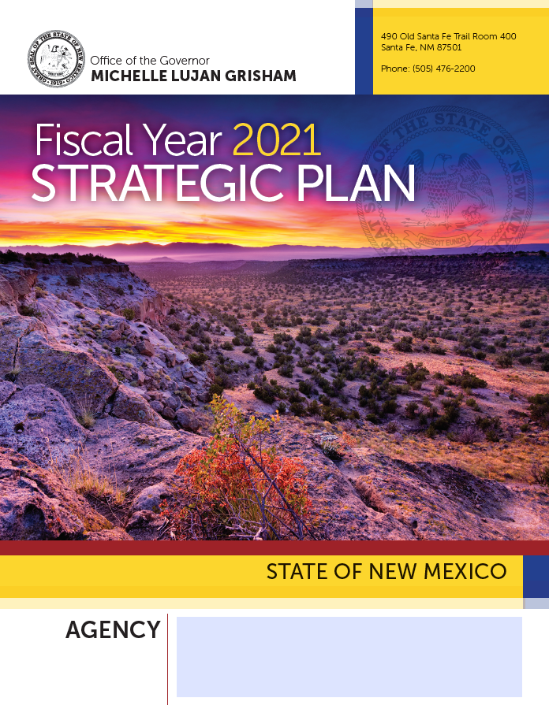
New Mexico Higher Education Department
2044 Galisteo Street, Suite 4
Santa Fe, NM 87505
(505) 476-8400

Slide 2
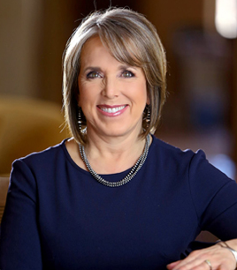
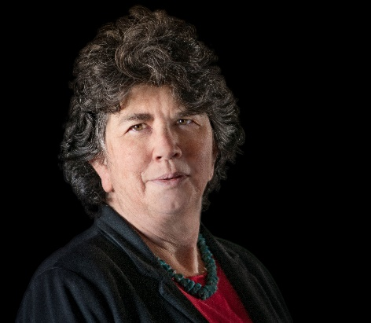
Leadership
Note from HED Cabinet Secretary Kate O’Neill, Ed.D.
Governor Michelle Lujan Grisham’s priorities
Transformative strategic investments in public education: My team will work hand-in-hand with educators, students, parents, and communities to build a higher education system that is accessible and equitable, and that provides New Mexicans with every single opportunity they need to succeed.
Access to high-quality higher education throughout the state: We will keep tuition low and leverage federal financial aid for Pell eligible students going straight from high school to college. We will ensure a tuition free start to college through the launch of New Mexico’s Opportunity Scholarship.
A Lottery Scholarship—now available to Tribal college students—that is vital and solvent on into the future: Further investments in the College Affordability Act, teacher and healthcare provider funds, and research endowments which will improve access and student success.
Environmentally sustainable Capital Outlay Projects: In line with the Paris Climate Accord, we will ensure a reduced carbon footprint and Leed level standards for all buildings on college campuses.
Sustainable investments in the workforce: After boosting the minimum wage for the first time in a decade, we will continue to expand our apprenticeships and invest in job training programs.
Enhanced collaboration for better data collection, analysis and dissemination: improved infrastructure, access, processing, analysis and use of student and institutional data. Build Longitudinal Data System across EEC, PED, HED, and DWS that fully uses a standard ID.
Higher Education changes lives. We are excited to roll out our vision for the future of Higher Education in New Mexico.
Our plan is anchored by:
Access
Affordability
Quality
Support
Student Success
I welcome feedback from stakeholders and look forward to serving all New Mexicans as we continue to move our state forward.

Slide 3
Table of Contents
Table of Contents
Vision, Mission, and Values…………….….………………………… 4
Organizational Structure……….......................................... 5
Overview………………………………………………………………………. 6
Budget………………………………………………………………………….. 7
Programs and Strategies……………………………………………….. 8
Activities……………………………………………………………………….. 9
Statutory Authority by Program…………………………………….. 10
Summary……………………………………………………………………….. 12

Slide 4
Dept. of Finance and Administration
Department of Finance and Administration
Vision, Mission, and Values
Vision, Mission and Values
OUR VISION
New Mexico will be known globally for accessible, affordable, high-quality postsecondary education and research.
OUR MISSION
Guide, serve, and support students and higher education institutions to ensure enhanced opportunities to recruit, retain, and graduate highly-skilled and well-informed graduates.
OUR GUIDING VALUES
Access, Affordability, Quality, Accountability,
Collaboration, Communication, Opportunity,
Effectiveness, Support, Service, and Success.

Slide 5
Policy Development, Fiscal Analysis, Budget Oversight and Education Accountability (P541)
Organizational Structure

Slide 6
Policy Development, Fiscal Analysis, Budget Oversight and Education Accountability (P541)
Overview
Purpose of the Department
HED provides accessible, quality research and oversight so that all stakeholders can benefit from higher education opportunities and make informed decisions for the enhancement of New Mexico and the world.
Program Users
Eligible students who seek undergraduate, graduate/professional, dual credit, workforce training, and/or adult education, from one of New Mexico’s higher education high-quality programs.
Benefits to New Mexicans
Access to adult and higher education
Affordable high-quality training
Affordable high-quality certificates and degree programs
Increased literacy and numeracy as well as social/emotional skills
Leverage of federal research, financial aid, and investment funds statewide
Improved health and socio-economic outcomes due to educational attainment
More highly skilled workforce
Retention of highly skilled workers
Increase in the percentage of college-ready, college enrolled, and graduating students
More informed and educated public

Slide 7
Policy Development, Fiscal Analysis, Budget Oversight and Education Accountability (P541)
Budget

Slide 8
Policy Development, Fiscal Analysis, Budget Oversight and Education Accountability (P541)
Programs and Strategies
Program Goals and Objectives
Deliver high quality and timely services related to academics, literacy and college-readiness programs, financial aid, capital outlay, budget oversight, legal, and information technology support
Provide comprehensive annual reporting
Ensure adequate training and educational attainment support for HED employees
Provide an overall positive experience for HED employees and constituents
Maintain positive employee morale through employee engagement and appreciation activities
Create successful pipeline and succession plan for key positions
Ensure Performance Management processes are designed and implemented to align and maximize individual performance with HED goals
Report on enrollment trends, degree and graduation rates, financial aid, time to degree, credit accumulation, credentials, faculty and research, student transfers, dual credit, common course numbering system, general education program, degree mapping, advanced placement, remediation rates, adult education demographic and performance data
Record, edit, audit, report, and archive all financial transactions for HED in compliance with all applicable state and federal laws and regulations and with generally accepted accounting principles
Ensure maintenance and access of closed school records, including student transcripts requests
Provide statewide academic instruction and education services to adults below the postsecondary level to increase their ability to read, write, and speak English and demonstrate knowledge necessary to attain a secondary school diploma, transition to postsecondary education and training, and enter a career pathway
Oversee and provide training and support to sub grantees receiving state and federal funding totaling about $10,000,000 to provide services to about 12,000 adult students each year
Participate as core partner under the Workforce Innovation and Opportunity Act with employers and postsecondary institutions to provide workforce preparation and training to New Mexicans with barriers to employment.
Strategic Actions
Expand college access and affordability
Provide training to Boards of Regents
Calculate the Higher Education Funding Formula
Provide budget and fiscal oversight
Collect and maintain data from higher education institutions through use of the Electronic Data Editing and Reporting (eDEAR) system
Prepare budget requests, operating budgets, and budget adjustment requests for HED
Oversee private postsecondary institutions

Slide 9
APPENDIX
APPENDIX
APPENDIX
Activities
Policy Development, Fiscal and Data Reporting
Program Support and Oversight
Implement the New Mexico common course numbering system, general education core program, degree mapping, statewide advanced placement policy, and dual credit program
Analyze and report on the effectiveness of the dual credit program
Analyze and report on how students move through New Mexico’s higher education institutions and whether the common course numbering system, general education core program, and degree mapping have improved transfer between institutions
Publish an annual accountability report that includes each higher education institution’s and sector’s graduation rates, average time to degree, average credit accumulation, most frequent credentials awarded, and information on faculty and research
Publish data reports addressing college remediation, enrollment, degree, graduation rates, financial aid, tuition and fees, funding formula data tables, and the NMHED Annual Report
Collect and maintain data from higher education institutions through use of the Electronic Data Editing and Reporting (eDEAR) system
Record, edit, audit, report, and archive all financial transactions for HED in compliance with all applicable state and federal laws and regulations and with generally accepted accounting principles
Prepare budget requests, operating budgets, and budget adjustment requests for HED
Central disbursement of cash to vendors
Central budgetary controls
Accounting for cash receipts and monthly reconciliation for cash to the State Treasurer’s financial reports
Allocation of appropriations from the State General Fund
Processing, recording, summarizing, and reporting financial transaction information
Annual production and audit of the State of New Mexico Comprehensive Annual Financial Report (CAFR)
Provide statewide academic instruction and education services to adults below the postsecondary level that increase their ability to read, write, and speak English and demonstrate knowledge necessary to attain a secondary school diploma, transition to postsecondary education and training, and enter a career pathway
Oversee and provide training and support to sub grantees receiving state and federal funding totaling about $10,000,000 to provide services to about 12,000 adult students each year
Participate as core partner under the Workforce Innovation and Opportunity Act with employers and postsecondary institutions to provide workforce preparation and training to New Mexicans with barriers to employment
Maintain demographic and performance data and report annually on high school credential attainment, transition to postsecondary education and training, employment and wage status, and educational skill level gains
Oversee private postsecondary educational institutions and public out-of-state authorization, and authorization for agents to recruit New Mexico students to attend out of state higher education institutions
Ensure maintenance and access of closed school records, including student transcript requests
Fiscal Management, Budget Approval, Capital Outlay and Oversight
Development of the Higher Education Funding Formula
Provide budget and fiscal oversight of higher education institutions and perform supplementary audit and monitoring functions when warranted
Administer the Executive Order 2013-006 for grants of state capital outlay appropriations
Oversee and provide training and support to higher education institutions receiving state capital outlay appropriations
Coordinate annual hearings for higher education institutions to request capital outlay funding in accordance with 5.3.9 NMAC
Provide review and approval of capital projects in accordance with 5.3.10 NMAC

Slide 10
Statutory Authority by Program
APPENDIX

Slide 11
Statutory Authority by Program
APPENDIX

Slide 12
Summary
APPENDIX
The New Mexico Department of Higher Education provides vital support, oversight, guidance, policy, reviews, and capital outlay coordination throughout the state. The Department oversees both public and private institutions of post-secondary education for the benefit of students, communities, and the state as a whole. HED’s goal is to support post-secondary educational attainment at the level of 66% of New Mexicans with a degree or credential by 2030 – the Route to 66!

